Slide 1
CAPSTONE PROJECT- Recommendation System
MENTOR: TEAM MEMBERS:
Dr.Srabashi basu Aniket Roy
Professor, Analytics & Quantitative Methods Girish Kumar
Great Learning Suraj Suresh
K.Varshini

Slide 2
CONTENT
Introduction
Data Preprocessing
Exploratory Data Analysis
Other Attempts
Scoring Function
Results
Conclusion
References

Slide 3
INTRODUCTION
INSURANCE ANALYTICS
The goal of this project is to recommend to the government, the top 50 counties to target first in order to increase the premium.
SCOPE OF THE PROJECT
The scope of the project is to increase its insurance premium for counties where incidence of Mortality caused by Cancer is high, which 50 counties should the government target first

Slide 4
DATA DICTIONARY
TARGET_deathRate: Mean per capita (100,000) cancer mortalities
avgAnnCount: Mean number of reported cases of cancer diagnosed annually
avgDeathsPerYear: Mean number of reported mortalities due to cancer
incidenceRate: Mean per capita (100,000) cancer diagoses
medianIncome: Median income per county
popEst2015: Population of county
povertyPercent: Percent of populace in poverty
studyPerCap: Per capita number of cancer-related clinical trials per county
binnedInc: Median income per capita binned by decile
MedianAge: Median age of county residents
MedianAgeMale: Median age of male county residents
MedianAgeFemale: Median age of female county residents
Geography: County name
AvgHouseholdSize: Mean household size of county
PercentMarried: Percent of county residents who are married

Slide 5
EDUCATION DETAILS
PctNoHS18_24: Percent of county residents ages 18-24 highest education attained: less than high school
PctHS18_24: Percent of county residents ages 18-24 highest education attained: high school diploma
PctSomeCol18_24: Percent of county residents ages 18-24 highest education attained: some college
PctBachDeg18_24: Percent of county residents ages 18-24 highest education attained: bachelor's degree
PctHS25_Over: Percent of county residents ages 25 and over highest education attained: high school diploma
PctBachDeg25_Over: Percent of county residents ages 25 and over highest education attained: bachelor's degree
PctEmployed16_Over: Percent of county residents ages 16 and over employed.
PctUnemployed16_Over: Percent of county residents ages 16 and over unemployed.

Slide 6
INSURANCE COVERAGE
PctPrivateCoverage: Percent of county residents with private health coverage
PctPrivateCoverageAlone: Percent of county residents with private health coverage alone (no public assistance)
PctEmpPrivCoverage: Percent of county residents with employee-provided private health coverage
PctPublicCoverage: Percent of county residents with government-provided health coverage.
PctPubliceCoverageAlone: Percent of county residents with government-provided health coverage alone
RACE
PctWhite: Percent of county residents who identify as White
PctBlack: Percent of county residents who identify as Black
PctAsian: Percent of county residents who identify as Asian
PctOtherRace: Percent of county residents who identify in a category which is not White, Black, or Asian
PctMarriedHouseholds: Percent of married households
BirthRate: Number of live births relative to number of women in county

Slide 7
DATA PREPROCESSING
DATA SET CHOSEN:
The final dataset at which we are working is the data which was aggregated from a number of sources including the American Community Survey (census.gov), clinicaltrials.gov, and cancer.gov.
MISSING VALUE TREATMENT:
The feature, which had more than 70 percent of the missing values of the total records, was removed from the analysis.
The remaining features which had missing values less than 20 percent of the total observations, was imputed with state wise median value.

Slide 8
ANOMALIES IN THE DATA:
The states of Kansas, Minnesota and Nevada had anomalies in the column AvgAnnCount and Incidence rate.
They had repeating values in all counties of these states.
Here the death rates were higher than the actual population of the county, which clearly intimidated about the anomaly in the data.
To solve this issue, we considered these states along with its neighbors, and binned the data based on the population size of all the counties present.
Followed by this, we found the median of AvgAnnCount of these bins and imputed this value in the improper counties of the 3 states (Kansas, Minnesota and Nevada).

Slide 9
OUTLIER TREATMENTS:
Since, almost all the variables had extreme outliers we have chosen 3*IQR instead of 1.5*IQR and as each record is sensitive to the county of the state, the outlier treatment will not be suitable

Slide 10
EXPLORATORY DATA ANALYSIS
INTRODUCTION:
EDA is a general approach to exploring datasets by means of simple summary statistics and graphic visualizations in order to gain a deeper understanding of the data.

Slide 11
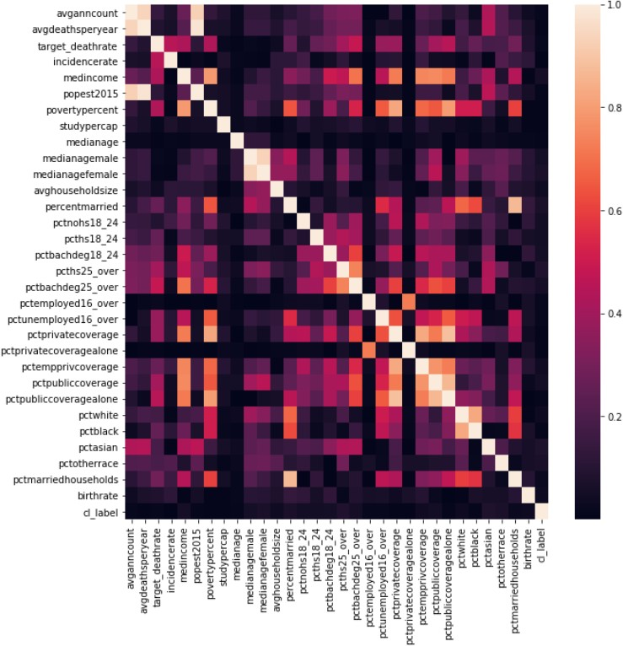
CORRELATION AMONG FEATURES
The above correlation heatmap shows that there is multicollinearity among the independent variables.

Slide 12
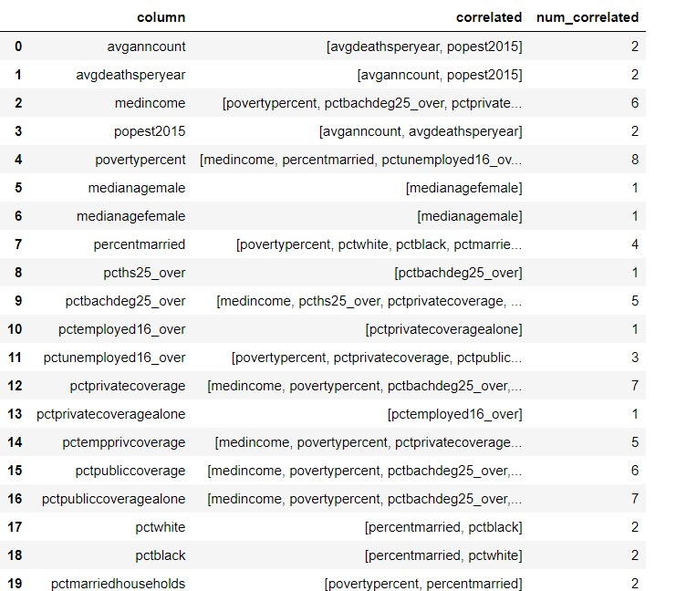

Slide 13
The education related features are highly correlated to the insurance related features.
People who are highly educated opt for private insurances.
People who are not highly educated opt for public insurances.
Also, people with high income are usually highly educated and therefore opt for private insurances. Whereas, people with low income are not highly educated and usually opt for public insurances.
All these above inferences are relevant and make sense.

Slide 14
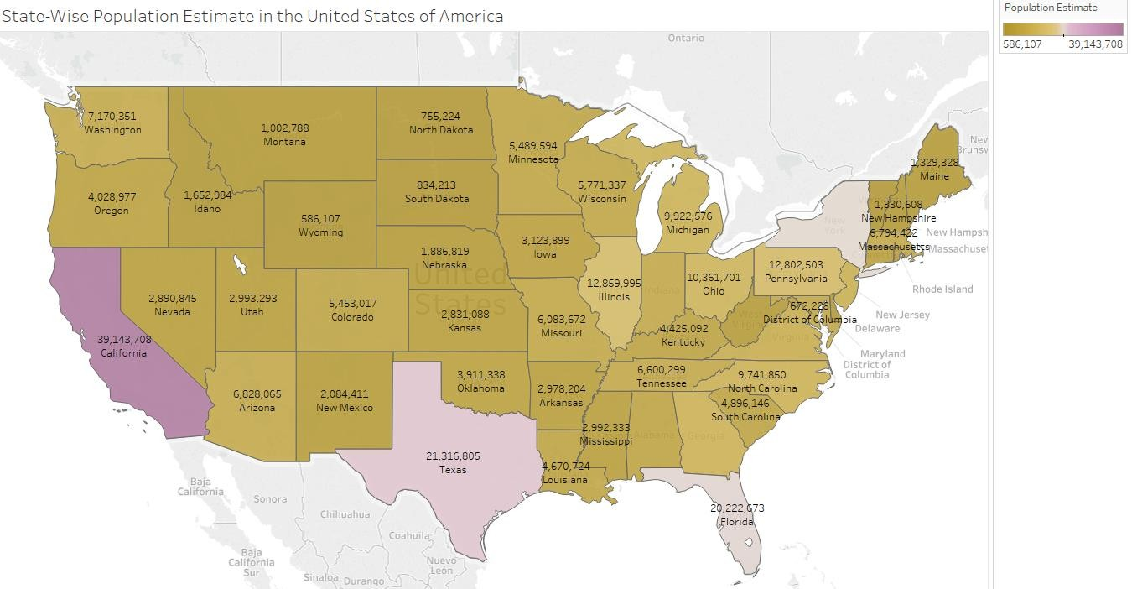
STATE-WISE POPULATION ESTIMATE IN THE US

Slide 15
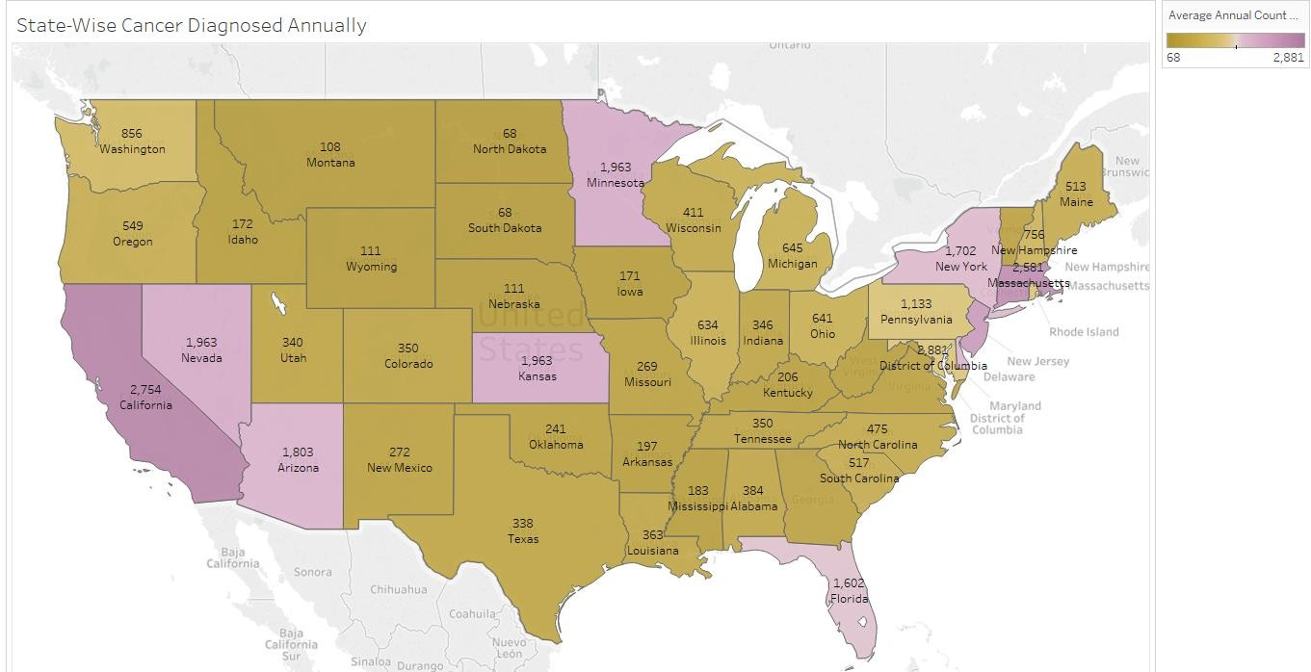
STATE WISE CANCER DIAGNOSED

Slide 16
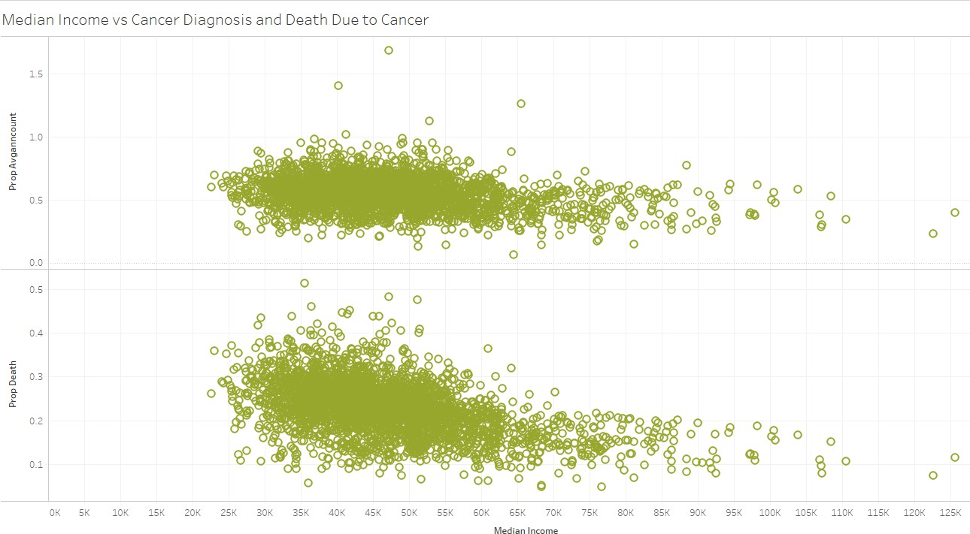
INCOME vs CANCER DIAGNOSED & DEATH DUE TO CANCER

Slide 17
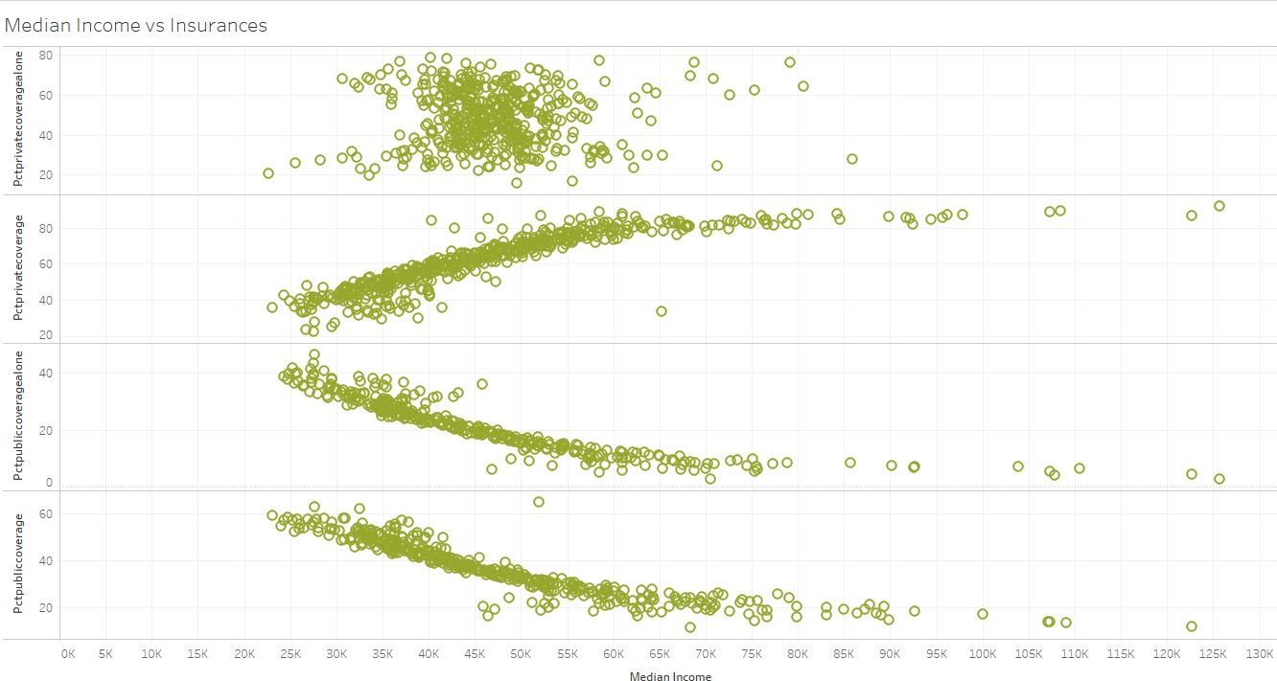
INCOME vs INSURANCES

Slide 18
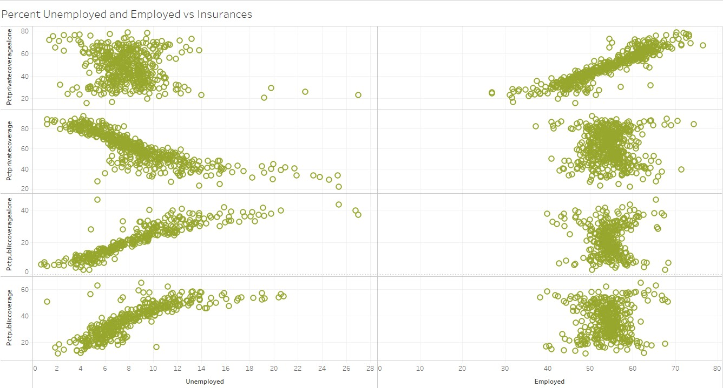
PERCENT UNEMPLOYED & EMPLOYED vs INSURANCES

Slide 19
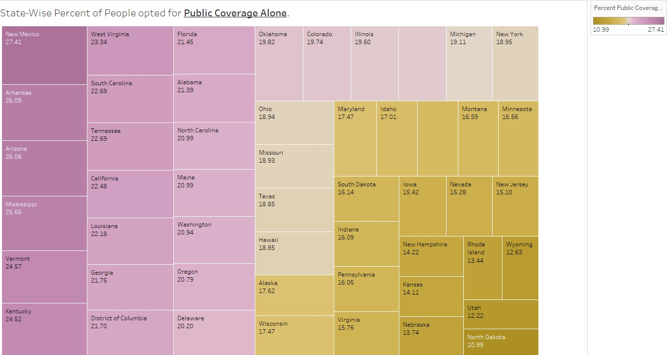
PERCENT PUBLIC COVERAGE ALONE

Slide 20
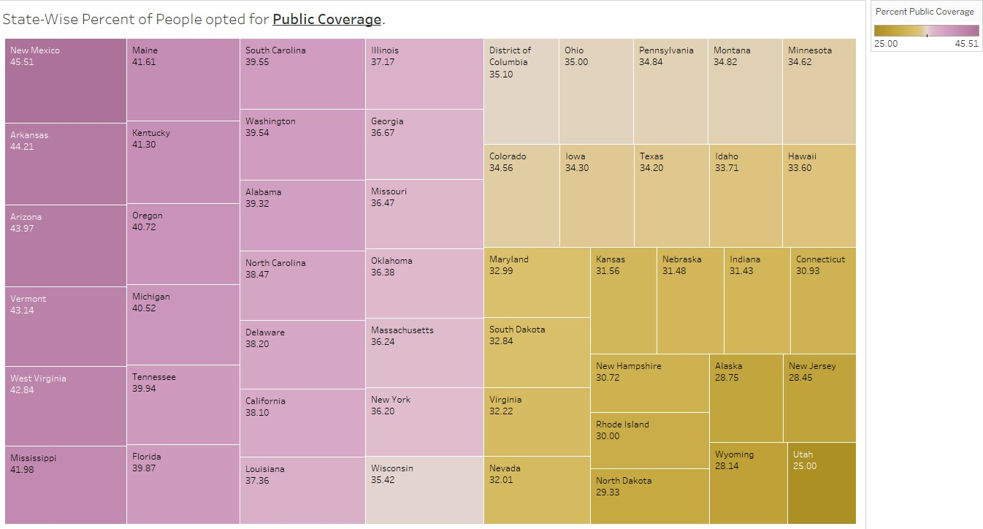
PERCENT PUBLIC COVERAGE

Slide 21
OTHER ATTEMPTS
Assuming this problem to be a regression problem, we built many regression models like Decision Tree, K Nearest Neighbors, Random Forest and Linear Regression only to find out that the models performance is very bad.
We engineered the following features and conducted many tests to see if they added any value to our analysis. But, were eventually not contributing to the project.
Proportion of people who have cancer out of the population = avgAnnCount/popEst2015
Proportion of Deaths due to cancer out of the entire population=avgDeathsPerYear/popEst2015
Proportion of deaths due to cancer out of the people who were diagnosed with cancer = avgDeathPerYear/avgAnnCount
Proportion of people who got tested for cancer out of the entire population = studyPerCapita/popEst2015
Proportion of people who had cancer after getting tested = avgAnnCount/studyPerCapita
Instead of the percentage, we took the actual count of the races present in the dataset. They did not aid in cluster formation.

Slide 22
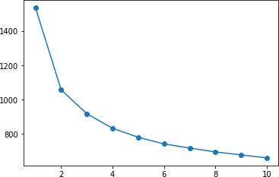
SCORING FUNCTION
From the elbow plot above, we found the ideal number of clusters to be 2.
After clustering using KMeans Clustering, we found the following centroid differences for the clusters as shown in the heatmap.

Slide 23
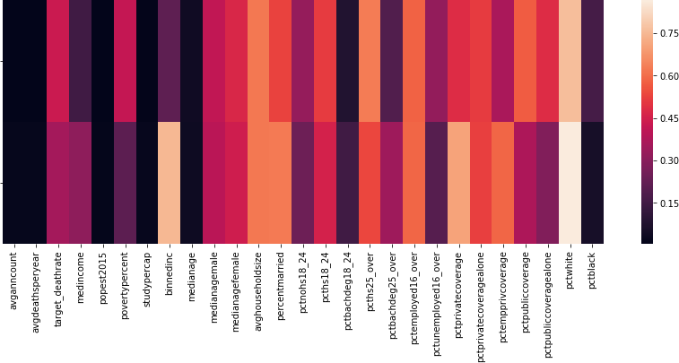
CORRELATION BETWEEN TWO CLUSTERS

Slide 24
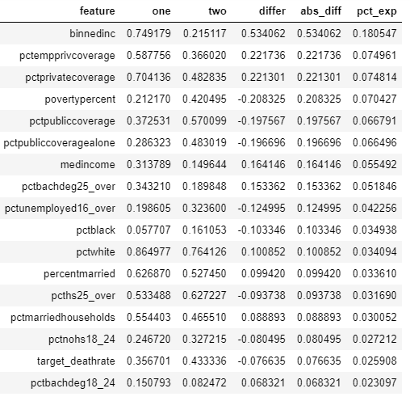

Slide 25
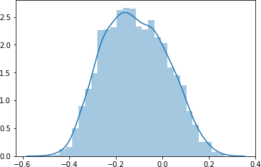
HISTOGRAM OF SCORES

Slide 26
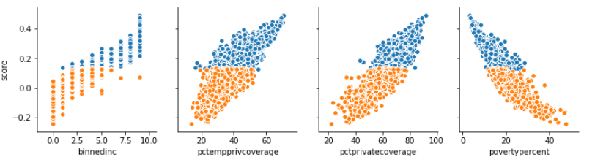
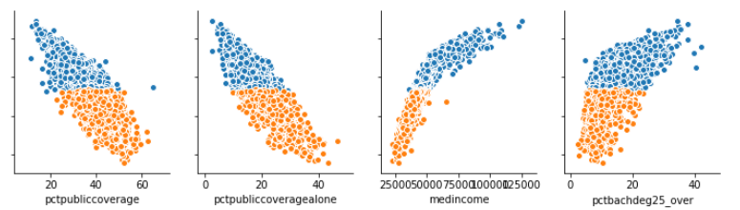

Slide 27
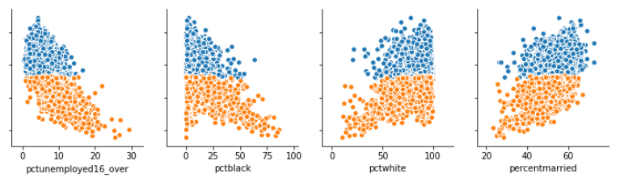
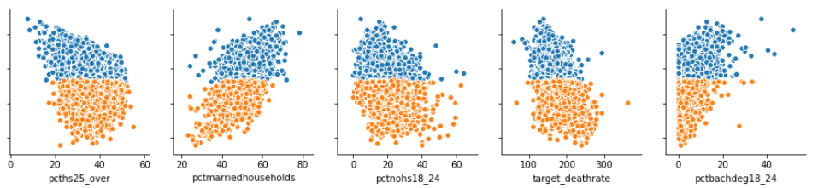

Slide 28
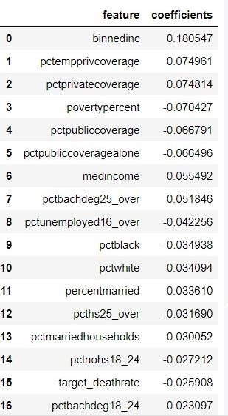

Slide 29
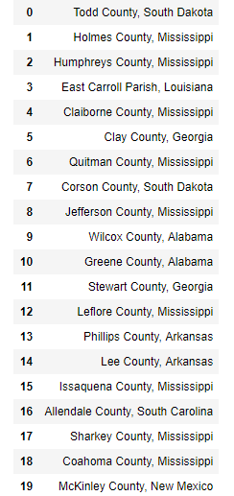
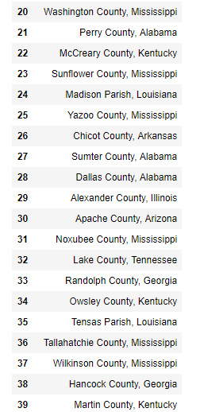
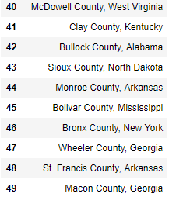
TOP 50 COUNTIES RECOMMENDED TO THE GOVERNMENT TO INCREASE THEIR PREMIUM

Slide 30
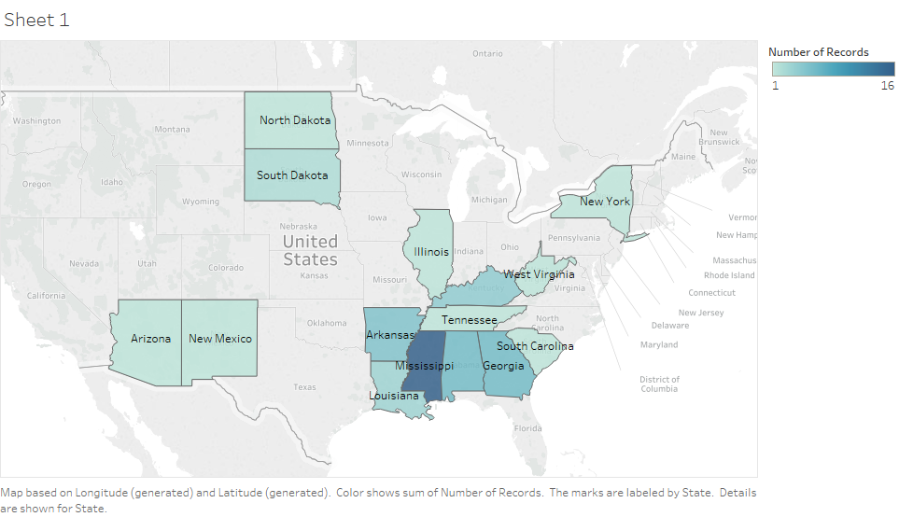

Slide 31
CONCLUSION
The scoring function that we built is good because we were able to get defined clusters.
From the 34 features we were able to find the 17 important features which explains 92% of the information.
There was a clear linearity in our scoring function with the other important features.

Slide 32
REFERENCES
The American Community Survey (census.gov)
Clinicaltrials.gov
Cancer.gov
www.analyticsvidhya.com
www.data.world/nrippner/ols-regression-challenge
www.ncsl.org/research/health/health-insurance-premiums.aspx

Slide 33
THANK YOU

